Slide 1
GOURMENT GUROS

Slide 2
Roadmap
Data sourcing
Data Preparation and Exploratory Data Analysis
Conclusions and Recommendations
1
3
5
2
4
6
Business and Data Understanding
Modelling and Evalulation
Deployment and Monitorng

Slide 3

BUSINESS UNDERSTANDING
The U.S. dining industry is diverse, yet finding restaurants that match specific preferences can be challenging due to a lack of centralized recommendation platform
Our solution offers tailored dining suggestions, enhancing the user experience and supporting local businesses.

Slide 4

MAIN OBJECTIVE
PROBLEM STATEMENT
Users struggle with generalized recommendations
There is a lack of real-time, location-specific suggestions.
To develop an intelligent system providing personalized recommendations based on user preferences and location

Slide 5

DATA UNDERSTANDING
Data Source: Yelp database for business and user review data.
Restaurant Data: 52,286 restaurants, 14 columns.
Review Data: 2.55M reviews, 4 columns.

Slide 6
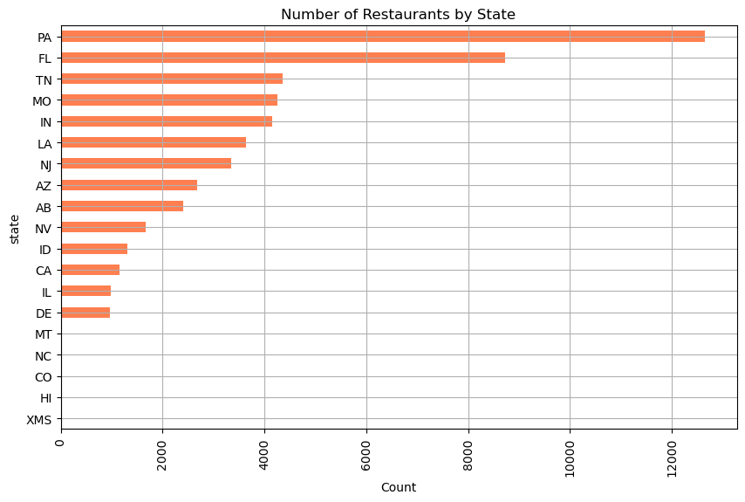
OBSERVATIONS AND FINDINGS

Slide 7
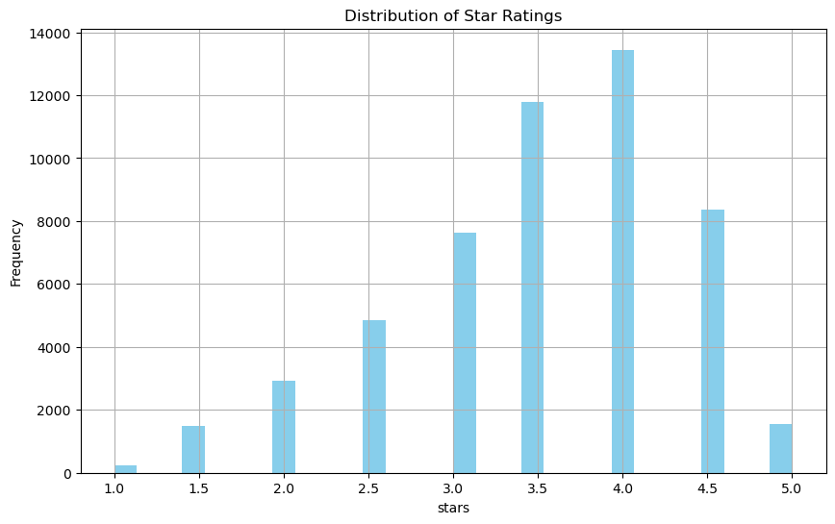

Slide 8
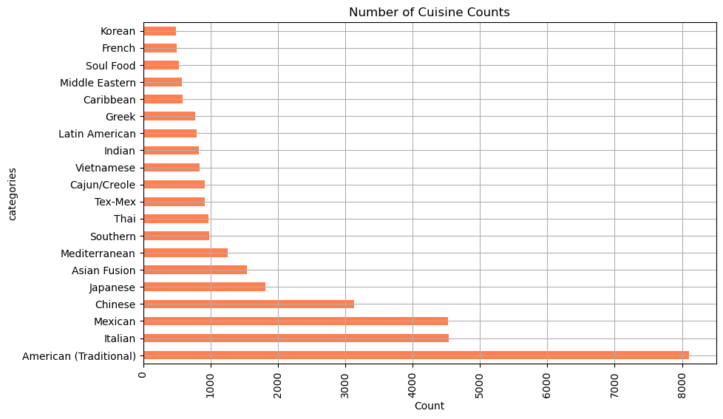

Slide 9
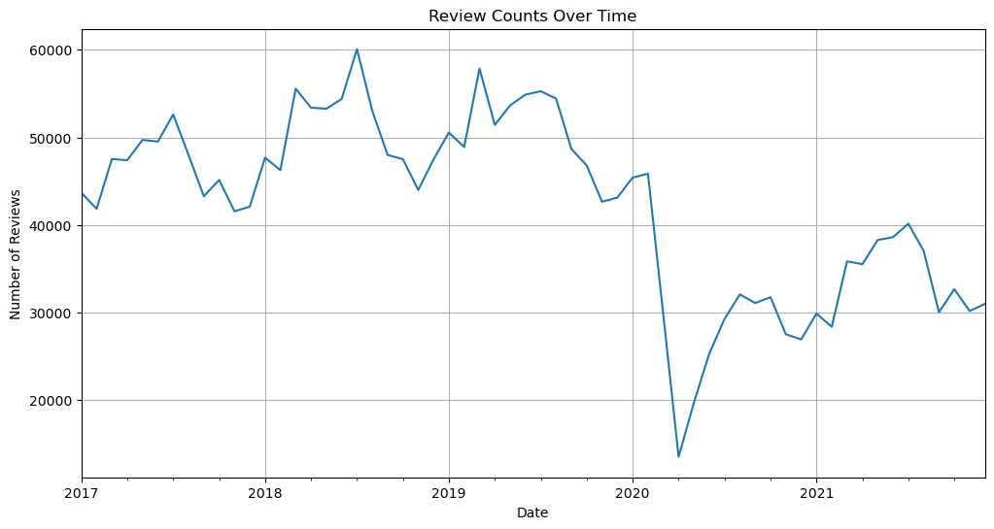

Slide 10

MODELING APPROACH
Content-Based Filtering
Utilizes restaurant features and attributes.
Implements cosine similarity and TfidfVectorization.
Collaborative Filtering
Uses user ratings with Surprise library.
Models: NormalPredictor, NMF, SVD, and tuned SVD.

Slide 11
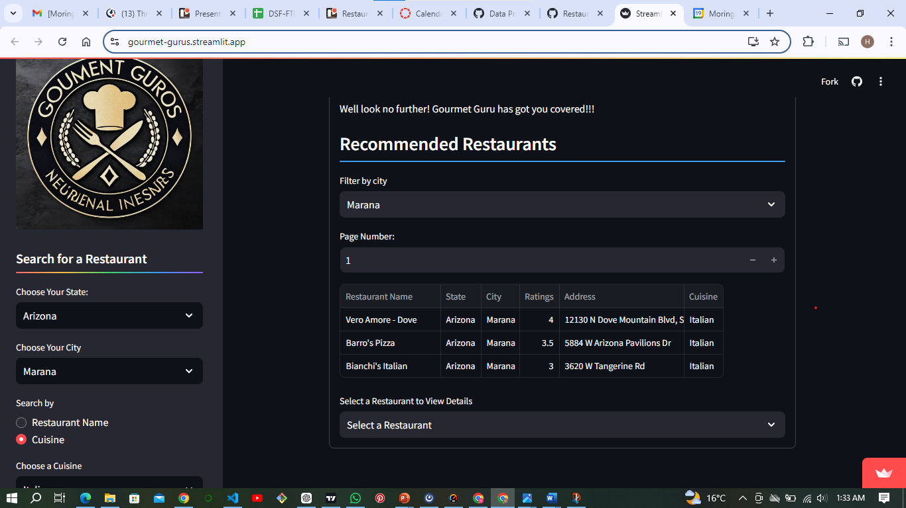
WEB APPLICATION

Slide 12

RECOMMENDATIONS
Prioritize Major Markets.
Tailor Recommendations to Market Size
Cuisine diversification.
FUTURE WORKS
Expand coverage to more regions.
Enhance user personalization features.
Variability of Cuisine choices

Slide 13

Hmm
yummy!!

